Slide 1
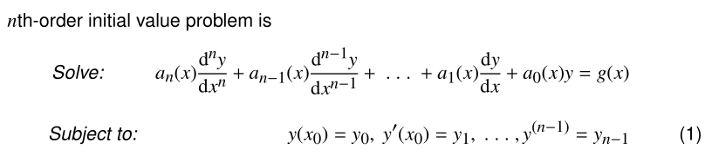
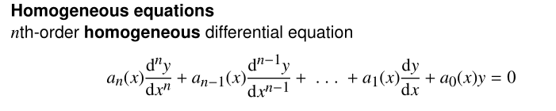
HIGHER ORDER DIFFERENTIAL EQUATIONS
HIGHER ORDER DIFFERENTIAL EQUATIONS
Nonhomogeneous

Slide 2
SOLUTION:
Superposition principle
Fundamental set of solutions
General solution
Particular solution

Slide 3



Reduction of order
the standard form

Slide 4
Example 1.

Slide 5


Homogeneous linear equations with constant coefficients
the second-order equation
auxiliary equation

Slide 7
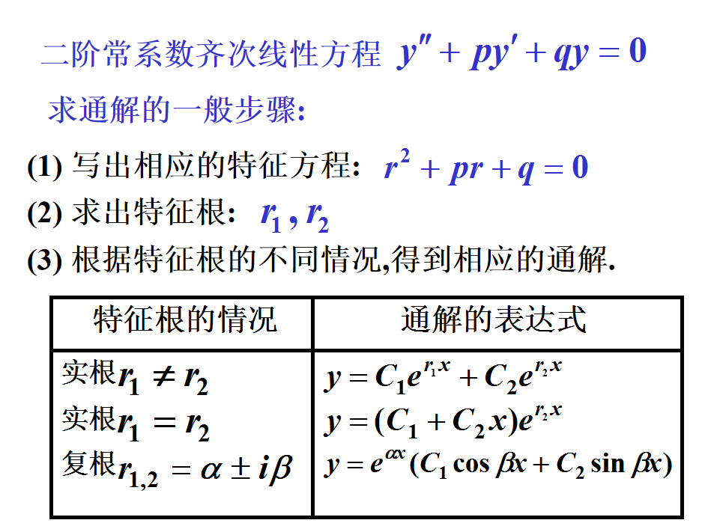

Slide 8
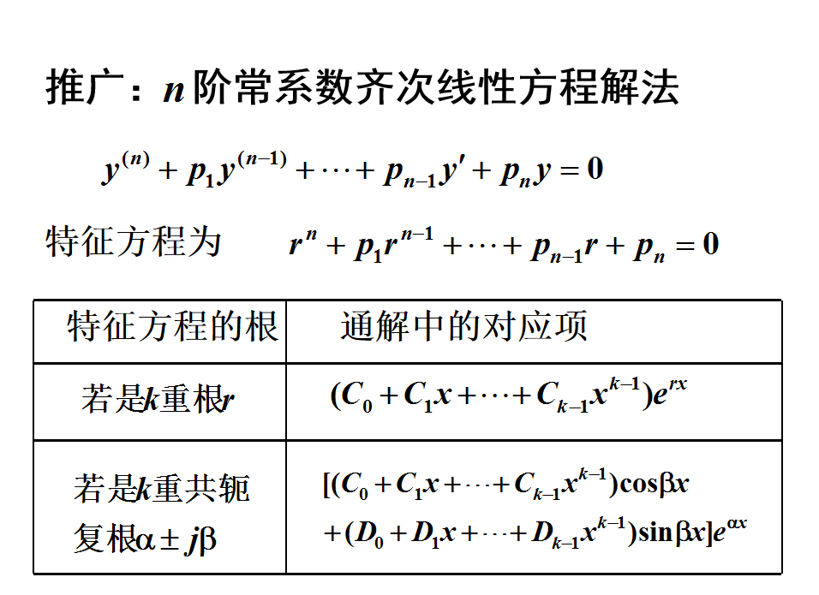

Slide 9

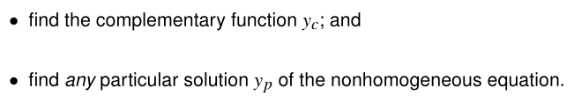
Nonhomogeneous linear equations with constant coefficients

Slide 10
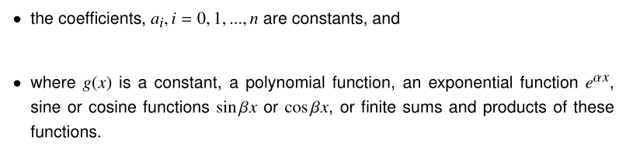
How to find a particular solution?
Method of undetermined coefficients

Slide 11
The types of g (x):
The particular solution:
λ is not a root of auxiliary equation
λ is a single root of auxiliary equation
λ is a repeated root of auxiliary equation

Slide 12
The particular solution:

Slide 13


Slide 14
Example.
Solution:
The auxiliary equation:
The roots are
So the complementary solution:
Subsititude it into the original equation:

Slide 15
Therefore, the general solution is

Slide 16



The method of variation of parameters
where y1 and y2 form a fundamental set of solutions on I of the associated homogeneous form.

Slide 17
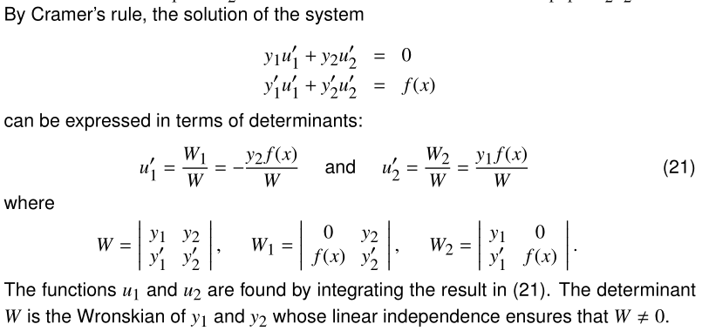

Slide 18


The solutions the associated homogenous equation are: sin(x) and cos(x).

Slide 19
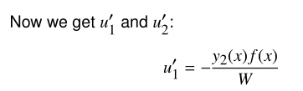

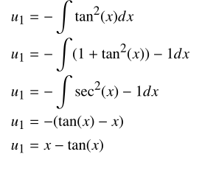

Slide 20








